Slide 1
Iterative Optimisation with an Innovation CNN **Thesis Proposal Review**
Gerard Kennedy
Supervisors: Robert Mahony, Xin Yu, Nick Barnes, Hongdong Li
1/57
Notes:
Say my name and supervisor

Slide 2
Overview
Motivation
Innovation CNN Introduction
Technical Talk: Initial Application
Object Pose Estimation
Formulation
Network Architecture
Evaluation
Design Choices
Initial Results
Future work
2/57
Notes:
First I’m going to go over the background and motivation for the work I’ll be presenting in this talk.
Then I’ll introduce our main concept – the Innovation CNN – in a general, high level way
The core of this talk is then going to be the application of the Innovation CNN to object pose estimation.
This is going to be the technical part of this talk, and will be broken down into an overview of the problem of object pose estimation, the formulation we used to apply the Innovation CNN to this problem, the network architecture we used, and how we evaluated its performance. Finally I’ll go over some design choices we’ve made recently, and present some initial results.
As this is a TPR I’ll end by briefly discussing some of the work that I hope to do in the future.

Slide 3
Motivation
3/57

Slide 4
Variables In An Estimation Problem
Input: the measured variables available to the estimation algorithm.
State: the set of internal variables that summarises all the information in the system.
Output: the variables that are required to be estimated.
4/57
Notes:
I’m going to begin at a high level with some broad definitions from systems theory.
For a typical estimation problem, such as many common problems in robotics and computer vision, there are three key ingredients.
[read slide]
In a CV problem, the input is typically an image or set of images, the state is some intermediate representation, which varies depending on the application, and the output might be image depth, or object pose, or any number of typical target variables.

Slide 5
State Estimation
State estimator: an algorithm that enables the extraction of information about features of a system that are not explicitly provided by the data, via estimation of an underlying state representation.
System model:
5/57
Notes:
In systems theory, an algorithm that is used to extract the desired output from the input via an intermediate representation is known as a state estimator.
In state estimation problems the system is assumed to satisfy this set of equations. Where “f” is the system model, and “h” is a function mapping the underlying state to the desired output.

Slide 6
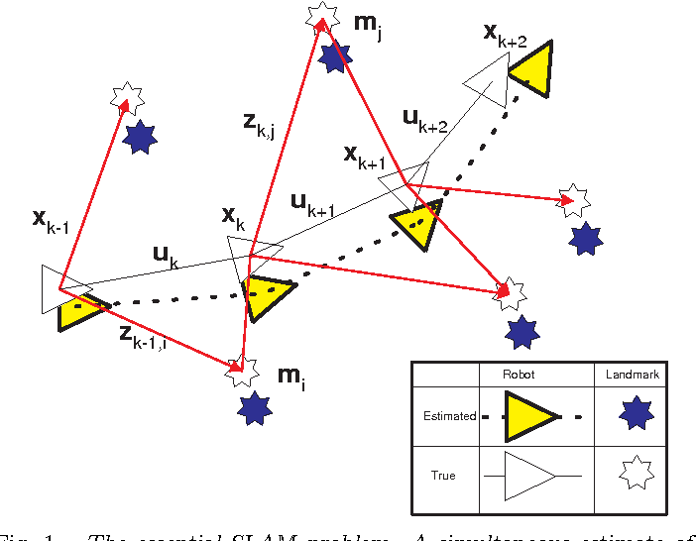
Online State Estimation
Updating the desired information as new data becomes available
Fundamental in robotics
Image from: Durrant-Whyte, Hugh and Tim Bailey. “Simultaneous Localisation and Mapping ( SLAM ) : Part I The Essential Algorithms.” (2006).
6/57
Notes:
State estimators are a common approach to solving online estimation problems.
Online estimation problems are problems that involve updating the state in an iterative process as new information becomes available.
This type of estimation problem is common in robotics, where the state might be the pose of the robot, the desired output might be a set of landmark poses, and the input might be a sequence of images and other sensor data such as an IMU.
Some examples of robotics problems that can be modeled in this way include SLAM (shown), and visual odometry.

Slide 7
State Example: Visual Odometry
7/57
Notes:
Here is an example of visual odometry as a state estimation problem.
It’s common to use the ‘hat’ notation to distinguish the variables of the estimator from the variables of the equations that satisfy the physical system.
Here there is an additional Delta term, which is called the Innovation. It’s role is to update the state to drive the estimated outputs towards the true outputs.
As I said briefly just before, the state here is commonly the robot pose, ‘y’ might be a set of landmark poses, for which the innovation can be defined as the difference between estimated and predicted landmark poses, along with some gain “K”.

Slide 8
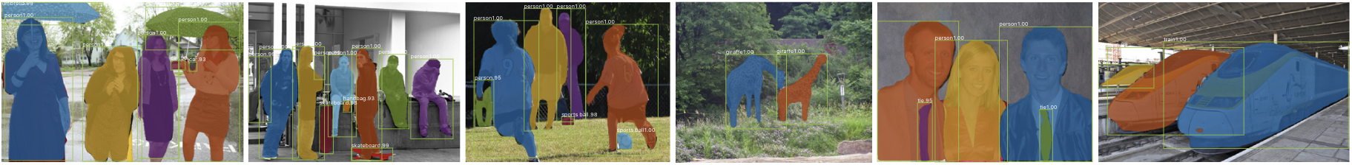
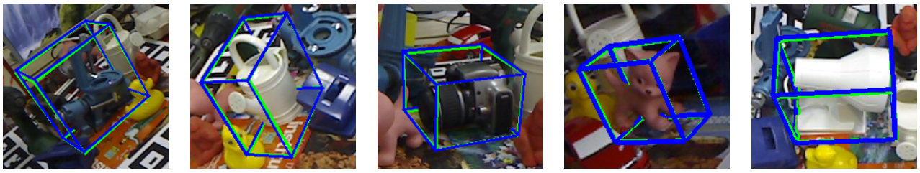
Offline State Estimation
Estimating output given fixed input data
Fundamental Computer Vision Problem
Top: K. He, G. Gkioxari, P. Dollár, and R. Girshick, “Mask r-cnn,” 2017.
Bottom: M. Rad and V. Lepetit, “Bb8: A scalable, accurate, robust to partial occlusion method for predicting the 3d poses of challenging objects without using depth,” 2017.
8/57
Notes:
So we’ve seen how estimation problems can be handled in online, robotics applications, but there is another broad class of estimation problems that most of us are probably more familiar with – offline state estimation problems.
These are problems for which the input data is fixed. In computer vision, the input data is almost always an image or sequence of images, and the aim is once again to take the given input information to the desired output information, via an intermediate representation which we can think of as the state.
In computer vision, it is common to perform this type of estimation problem with some form of neural network.
The examples here involve estimating a segmentation mask, and estimating an object pose, both given as image as input.

Slide 9
Problem Motivation
Offline estimation = learning
Online estimation = filtering/observing
How could these be combined and applied to both categories of estimation problem?
Deep learning
Filtering/Observing algorithms
??
9/57
Notes:
Within robotic vision, offline = learning, online = filtering
We want to find a technique that combines the data-driven advantages of deep learning with the knowledge-driven advantages of filtering/observing algorithms
This technique would be a general approach to state estimation that could be applied to both online and offline problems.

Slide 10
Innovation CNN
10/57
Notes:
And with that motivation in mind we are presenting the Innovation CNN

Slide 11
The Innovation CNN
Innovation: the difference between the current state and the predicted state
Typical Approach Proposed Approach
11/57
Notes:
As I’ve said, the typical approach to computer vision problems is to find a mapping from the input data (which is typically images), straight to the desired state.
However, an alternative formulation of the problem would involve taking some model of the state, and then estimating the innovation – the difference between the current state and the predicted state, and using this to correct the state model.

Slide 12
The Innovation CNN
Classical:
Innovation:
12/57
Notes:
In graphical form, here is how our proposed approach differs from the more common approach to deep learning problems.
If we take the example of a common object pose estimation, the top pipeline involves taking an image and estimating either a vector field, or some keypoint representation. From here the desired output (the object pose) can be obtained by matching 2D-3D correspondences via a PnP algorithm.
On the other hand, our approach involves taking an image and estimating the difference between the state estimated by the network and the desired state. Once we have the innovation we can use it to iteratively refine the state, and then obtain the object pose via the same PnP algorithm.

Slide 13
The Innovation CNN
For online state estimation
Problems often `solved’ with filtering algorithm (eg. Kalman filter)
An Innovation CNN can be implemented to learn the innovation term
The measurements are provided by the robot’s sensors and the initial state is typically identity
13/57
Notes:
[read over slide]

Slide 14
The Innovation CNN
For offline state estimation
An Innovation CNN can be formulated from a CNN for offline state estimation by learning a suitable innovation term
The initial state estimate can be taken from the output of the original network
The initial estimate can be updated in an iterative framework
14/57
Notes:
[read over slide]
This is the approach we take to refine an object pose estimate, which I’ll discuss in more detail later.

Slide 15
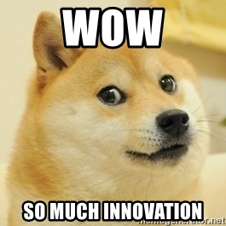
The Innovation CNN
Deep learning
Innovation
CNN
Filtering/Observing algorithms
Good
idea
Obligatory
tenuous
meme
Good
dog
15/57
Notes:
We began with the goal of trying to find an approach to general state estimation problems that incorporates the advanges of data-based learning techniques and knowledge-based filtering techniques.
Provides a framework for state estimation techniques to be incorporated into offline estimation problems
Provides a framework for learning-based techniques, such as a CNN, to be incorporated into online estimation problems
Potential to be applied to a wide range of state estimation problems in robotic vision
Plus there’s also a dog involved somehow. So there’s something for everyone.

Slide 16
Concept Demonstration
Choose a trial problem: Object pose estimation (Offline)
Select a pose estimation network
Learn to estimate an innovation term which we can use to refine the state
16/57
Notes:
So that concludes the general overview of what we’re trying to do, and why. The next step is to choose an example estimation problem and test the concept.
[read points]
What we hope to show is that the Innovation CNN is a general framework that can be applied to this problem to improve the initial state estimate.

Slide 17
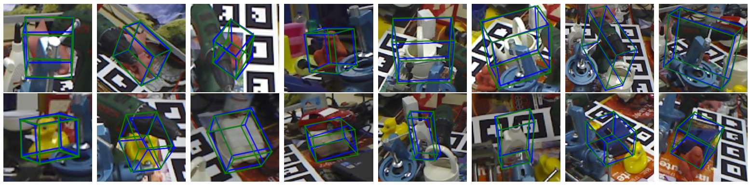
Technical Talk
Initial application: Object pose estimation from a single RGB image
Offline estimation problem
Typically implemented with CNN
Image from: S. Peng, Y. Liu, Q. Huang, X. Zhou, and H. Bao, “Pvnet: Pixel-wise voting net-work for 6dof pose estimation,” in CVPR, 2019
17/57
Notes:
The next section is the main body of the talk, which focuses on applying the idea of the Innovation CNN to the offline estimation problem of object pose estimation from a single RGB image.
This is work conducted in collaboration with Xin and Zheyu, to whom I am very grateful.

Slide 18
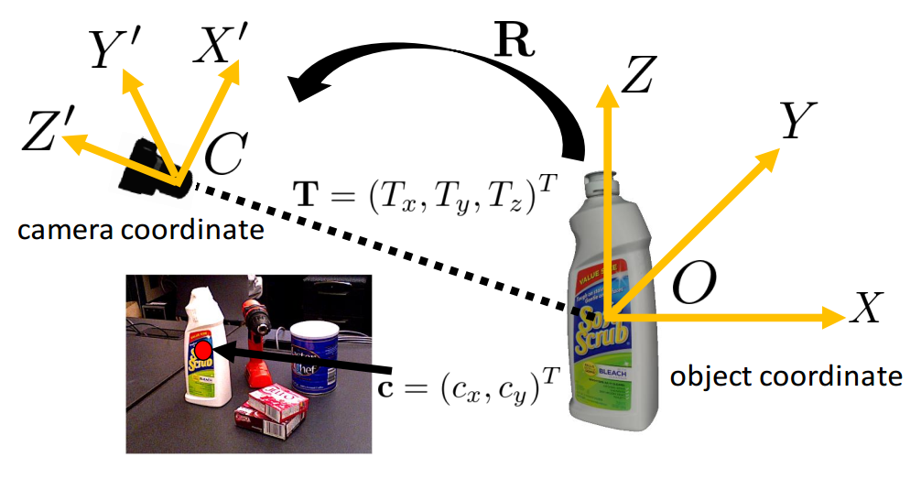
Object Pose Estimation
6D object pose estimation from a single RGB image
Image from: Y. Xiang, T. Schmidt, V. Narayanan, and D. Fox, “Posecnn: A convolutional neu-ral network for 6d object pose estimation in cluttered scenes,” 2017
18/57
Notes:
I’m going to start by giving a brief overview of the problem of object pose estimation
The problem: estimating the rotation and translation of a given object with respect to reference frame of the camera.
Estimation from an RGB image, rather than depth, is of interest because of depth camera limitations such as frame rate, field of view, resolution, depth range, and environmental constraints such as lighting.

Slide 19
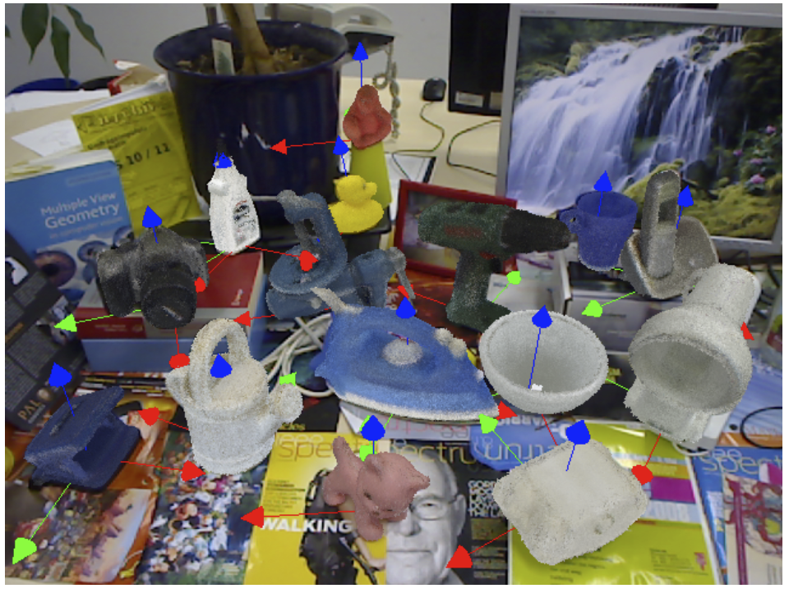
Object Pose Estimation
Highly challenging due to viewpoint ambiguity and object symmetries
Image from: S. Hinterstoisser, K. Konolige, and N. Navab, “Model based training, detection and pose estimation of texture-less 3d objects in heavily cluttered scenes.”
19/57
Notes:
[read slide]
This image is from a common dataset for object pose estimation.
Some objects, such as the cat, are much simpler to estimate than objects such as the bowl that contain an axis of symmetry.
It’s also challenging because of factors such as lighting, pose variations, occlusions, and object texture.

Slide 20
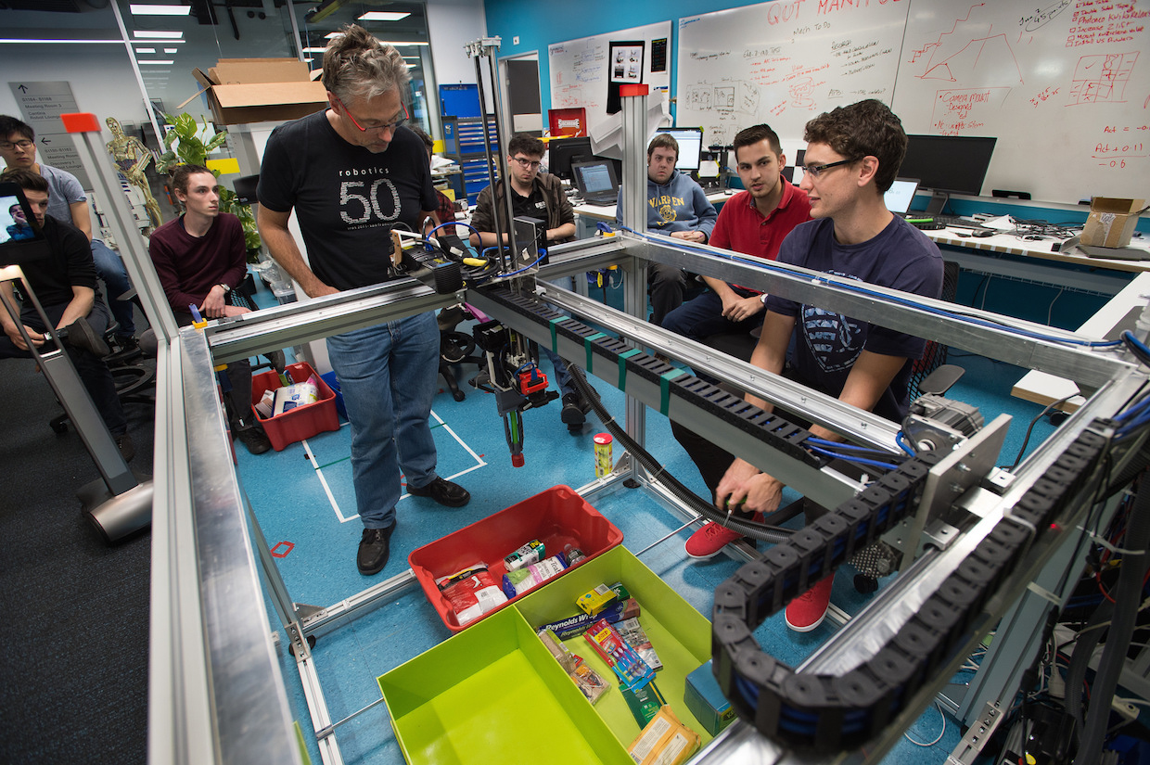
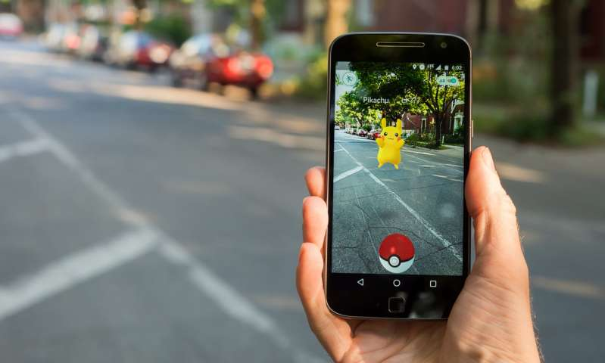
Applications
Robotic manipulation and grasping (Amazon picking challenge)
Scene understanding
Virtual and augmented reality
Photo: Anthony Weate/QUT
https://phys.org/news/2018-11-augmented-reality.html
20/57
Notes:
Object pose estimation has a range of applications within robotics and computer vision.
Accurate object pose is central to tasks that involve robotic manipulation or grasping, and for tasks that require a complete representation of objects in the scene for purposes such as augmented reality.

Slide 21
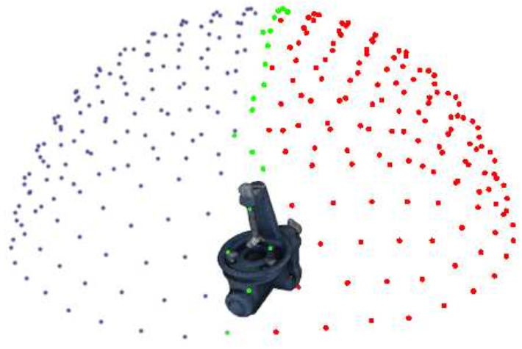
Common Approaches
End-to-end regression
Classification via discretised pose space
Regression to intermediate representation (keypoints) followed by PnP
Pose refinement
Image from: W. Kehl, F. Manhardt, F. Tombari, S. Ilic, and N. Navab, “Ssd-6d: Making rgb-based 3d detection and 6d pose estimation great again,” 2017
21/57
Notes:
Within the object pose estimation literature, there are several standard ways of approaching the problem.
Earlier work focused on end-to-end regression, which is challenging because of the highly non-linear relationship between orientation and translation.
Other work has attempted to discretise pose space, or at least rotation space (as shown in the image), but this only leads to a coarse representation that requires refinement.
Currently the most popular approach involves regressing to an intermediate representation, such as keypoints, from which pose can be obtained in a post-processing step.
There have also been several works that focus mainly on refining an initial pose estimate.
I won’t go into these different approaches, although it is worth noting that the problem of pose refinement is essentially what we are trying to do, as our goal is to iteratively improve an initial pose estimate.
For this reason I will quickly review the current approaches to pose refinement.

Slide 22
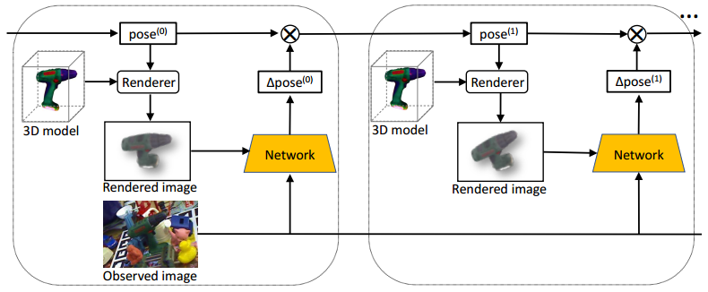
Pose Refinement
Image from: Y. Li, G. Wang, X. Ji,Y. Xiang, and D. Fox, “Deepim: Deep iterative matching for 6d pose estimation, ”International Journal of Computer Vision, vol. 128, no. 3, p. 657–678, Nov 2019. [Online]. Available: http://dx.doi.org/10.1007/s11263-019-01250-9
22/57
Notes:
All the current approaches to object pose refinement involve taking an initial pose estimate and a 3D CAD model of the object as input, and using the initial pose to render the target object. A relative pose transformation that matches the rendered view against the observed image is then estimated by the network.
This scheme, and all current pose refinement networks therefore require a 3D object model, and are specific to the problem of object pose estimation, rather than a general framework
These networks could be tacked onto the end of our estimation pipeline, once we refine the underlaying state to produce an updated pose estimate.

Slide 23
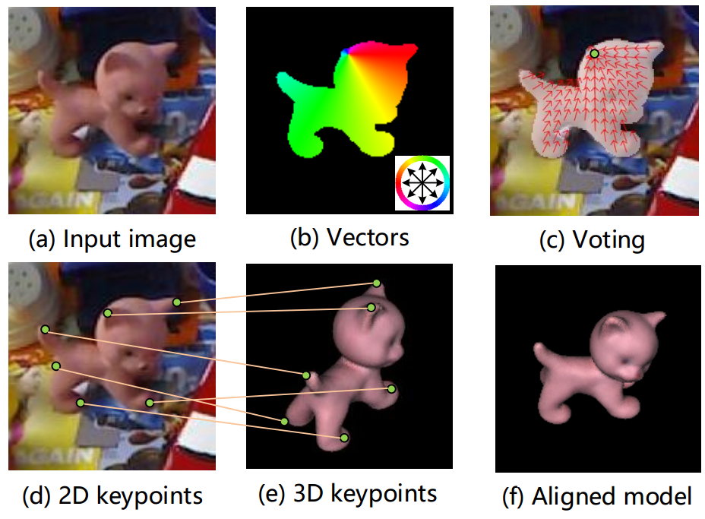
PVNet
Image from: S. Peng, Y. Liu, Q. Huang, X. Zhou, and H. Bao, “Pvnet: Pixel-wise voting net-work for 6dof pose estimation,” in CVPR, 2019
23/57
Notes:
PVNet utilises the popular approach of regressing to an intermediate representation of keypoints, before obtaining pose via a PnP algorithm.
PVNet defines a set of keypoints on the target object.
For each pixel, the object label and unit vectors from that pixel to each keypoint are predicted (b) and (c).
A RANSAC-based voting scheme is used to choose keypoints, after which a PnP algorithm is used to match 2D and 3D keypoints and obtain object pose (d) and (e).
So the output of the network is not pose, it is a vector field containing a set of unit vectors from each pixel to each keypoint. This is the state that we want to refine.

Slide 24
Problem Formulation
24/57

Slide 25
Innovation CNN for Pose Estimation
Model:
Then:
This can be formulated as a S.G.D problem:
25/57
Notes:
[go over slide]
So our aim for this pose estimation problem is to estimate the gradient of the state, and use that to refine our state estimate using stochastic gradient descent. This will hopefully lead to a refined output representation, which would be a refined object pose.

Slide 26
Innovation CNN for Pose Estimation
26/57
Notes:
[go over slide]
So our aim for this pose estimation problem is to estimate the gradient of the state, and use that to refine our state estimate using stochastic gradient descent. This will hopefully lead to a refined output representation, which would be a refined object pose.

Slide 27
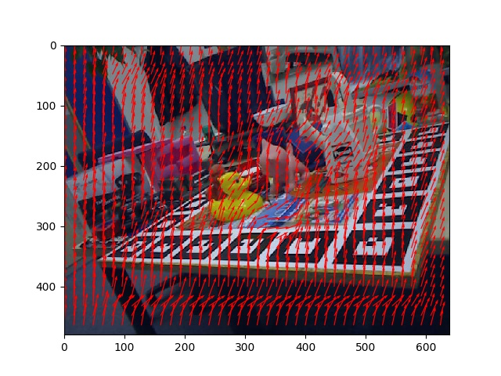
Problem Formulation
State estimate:
27/57
Notes:
We begin by defining the state that we’re estimating.
The state consists of unit vectors, computed via the second equation.
The dimensionality of the state is obtained from the size of the input image (M,N) and the number of keypoints.
[mention change in indexing: k to t]

Slide 28
Problem Formulation
State gradient:
28/57
Notes:
Given that PVNet estimated the state, we can estimate the gradient of the state by using the gradient of their loss function (which we denote with Phi) with respect to the state estimate.
This gradient term is what we want our Innovation CNN to estimate.

Slide 29
Problem Formulation
State update:
29/57
Notes:
Given the state and the gradient of the state, we can now formulate the update equation.
The update equation utilises simple gradient descent, with a step size that must be determined by the user.
As a different step size can be chosen for training and evaluation, we have assigned different notation for these possibly different parameters.

Slide 30
Innovation CNN for Pose Estimation
Image
Initial state estimate
State estimate (vector field)
State gradient
(gradient of vector field)
Update State estimate
30/57
Notes:
Given the formulation so far this is a high-level view of what we’re trying to achieve. We’re taking an input image, and an initial estimate from PVNet, and we’re trying to estimate the gradient of the state, which is this vector field representation. Then we’re going to use SGD to iteratively refine the state for some number of iterations. Then we can continue with the standard pose estimation pipeline, and map the vector field to an object pose via RANSAC and PnP.

Slide 31
Iterative Refinement
31/57
Notes:
Visually, this is what we’re trying to do.
If you consider that we begin with two data manifolds; one for the ground truth vector field, and one for the vector field estimated by PVNet, we’re hoping to iteratively move from the PVNet manifold to the true manifold.
We call the total distance that we move the `interpolation distance’, and give it the notation rho.
Thus rho_E is the interpolation distance during model evaluation, while rho_T is the interpolation distance during training.

Slide 32
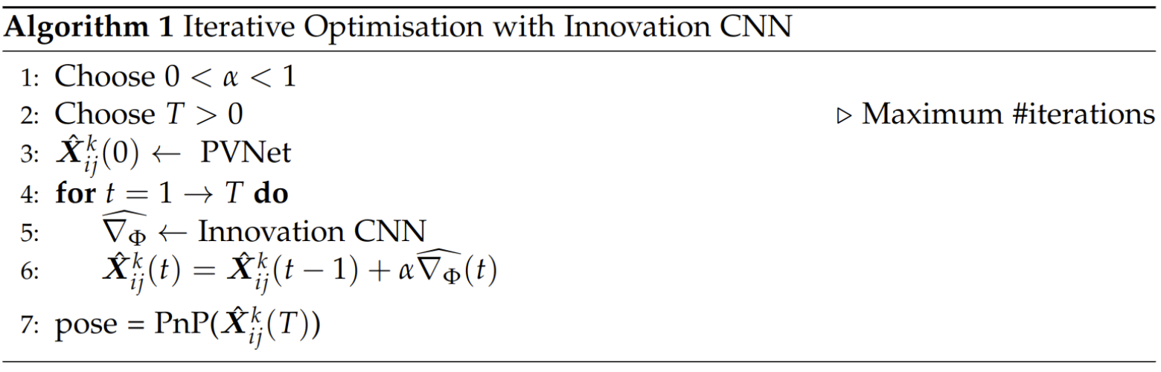
Innovation CNN for Pose Estimation
32/57
Notes:
The figure on the previous slide can also be presented in an algorithm.
Here the initial state estimate is provided from PVNet, a set number of iterations are performed where the state is updated, before a PnP algorithm is applied to obtain the pose from the final state.
Within this algorithm the previous figure illustrates the portion contained within the for-loop

Slide 33
Network Architecture
33/57

Slide 34
Network Architecture
State
Estimate (vector field)
Image
PVNet
PVNet Loss
Skip
connection
Information
flow
34/57
Notes:
To build our network, we begin with the original PVNet.
The network receives an image and returns a vector field.
The loss is a function of the set of keypoints Kappa and the pixels within the segmentation mask S

Slide 35
Network Architecture
State
gradient
Reformulated loss
Skip
connection
Information
flow
35/57
Notes:
We want the network to estimate the gradient of the state.
This is easy to do by reformulating the loss using the term we found by taking the gradient of PVNet’s loss with respect to the state estimate.
However this network doesn’t include a previous state estimate as input.

Slide 36
Network Architecture
State
estimate
State estimate
estimate
PVNet
Reformulated loss
Skip
connection
Information
flow
36/57
Notes:
To incorporate the previous state estimate, we take another copy of PVNet and use it as a state estimate autoencoder.
The estimate autoencoder is used as an auxiliary task aimed at allowing information from the previous estimate to be injected into the network via skip connections
This is an example of leveraging domain specific information via multi-task learning, and we’re hoping that by sharing representations between two related tasks we can perform better than we would on each task individually.

Slide 37
Network Architecture
State
gradient
Image
State
estimate
State estimate
estimate
Update state
estimate
37/57
Notes:
Finally, we can add the feedback loop that allows iterative refinement to occur.
This is the final network architecture: an Innovation CNN for object pose estimation.

Slide 38
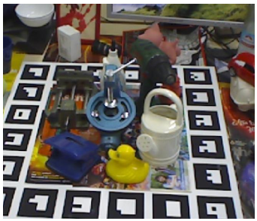
Network Architecture
Conv, BN,
ReLU
Res block
Res block with dilated conv
Information
flow
State
decoder
Gradient decoder
Max pool
Res block with strided conv
Bilinear upsampling
Skip connection
Resnet-18 feature encoder
38/57
Notes:
The individual layers of our network correspond very closely to those of PVNet.
[point to things with mouse]
A pretrained Resnet-18 is used as the feature encoder for both the input image and the previous state estimate.
Both decoders consist of alternating bilinear upsampling and convolutional layers

Slide 39
Network Training
39/57
Notes:
The loss functions are summarised here. There is one function for each of the two network blocks. One for the state autoencoder, and one for the state gradient UNet.
K: keypoints
S: segmentation mask

Slide 40
Evaluation
40/57
Notes:
That concludes the overview of the network architecture and network supervision. Next I’ll discuss how we evaluation the output of the trained network.

Slide 41
Evaluation Metrics
Standard metrics:
The pose is considered correct if the average distance is <10% of the 3D model diameter
The metric reported is the % of correct poses
41/57
Notes:
Transform the model points using the estimated and ground truth poses, respectively, and compute the mean distance between the two transformed point sets.
The pose is considered correct if the average distance is <10% of the 3D model diameter

Slide 42
Evaluation Metrics
Standard metrics:
The pose is considered correct if the average error is <5 pixels
The metric reported is the % of correct poses
42/57
Notes:
Computes the mean distance between the projections of 3D model points given the estimated and ground truth poses.
The pose is considered correct if the average error is <5 pixels

Slide 43
Evaluation Metrics
Problem specific metric:
43/57
Notes:
Aside from the two standard metrics for evaluating the performance of object pose estimation networks, we have included an additional, problem specific metric.
The two previous metrics both evaluate performance after the PnP step in the estimation pipeline. Given that this step contains a RANSAC voting scheme, it’s harder to rely on the result of these metrics to determine relative performance when making network design choices. We’ve therefore introduced this metric as it targets the raw output of the Innovation CNN.
In the next section, when I discuss some recent design choices, this metric is the most reliable for determining the validity of these choices.

Slide 44
Design Choices
44/57
Notes:
At the moment we’re at the stage where we’re testing the architecture on a small part of a standard object pose dataset, and trying to optimise the network parameters before we move in to an evaluation phase and apply the network to the full dataset.
This section goes over some of the recent design choices we’ve made.

Slide 45
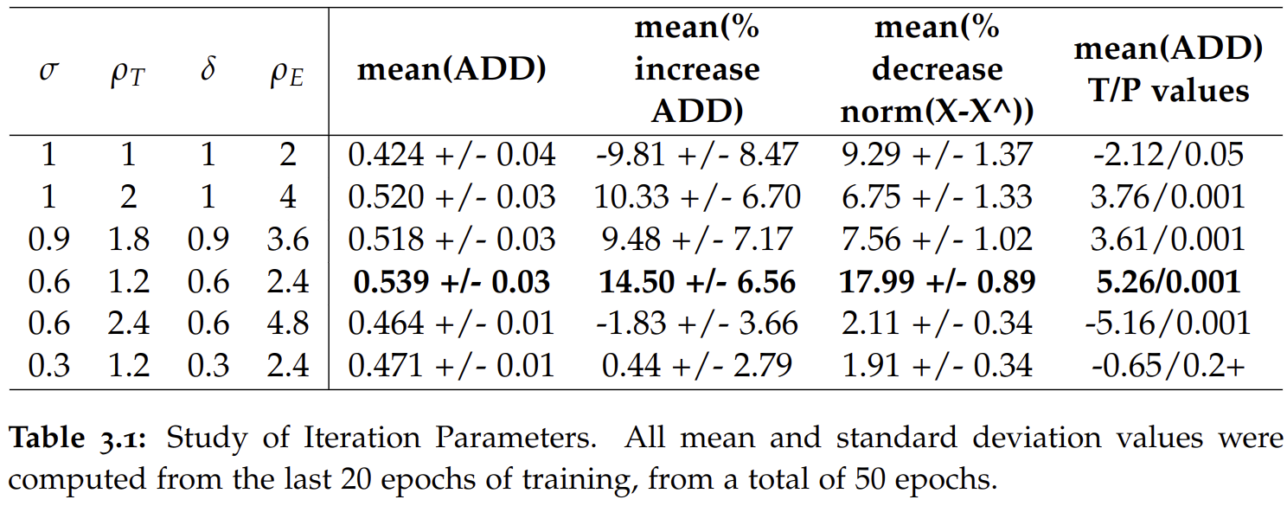
Choosing Parameters
Baseline PVNet: 47.2% (ADD)
45/57
Notes:
Some key design choices are what should the step size during training and evaluation be, and what should the interpolation distance during training and evaluation be.
[remind what interpolation distance is]
At this stage we have run a number of experiments on a network trained for 50 epochs on the Ape object of the Linemod dataset.
[explain all metrics used in table]
[remind that because of RANSAC its hard to compare exps]
[Welches T-test & probability that ADD means are drawn from different distributions)
However, it seems that it is preferable to choose a step size of between 0.5 and 1. We have chosen the interpolation distance to only allow for 2-4 iterations at this stage, mainly because of the corresponding increase in training time for more iterations.

Slide 46
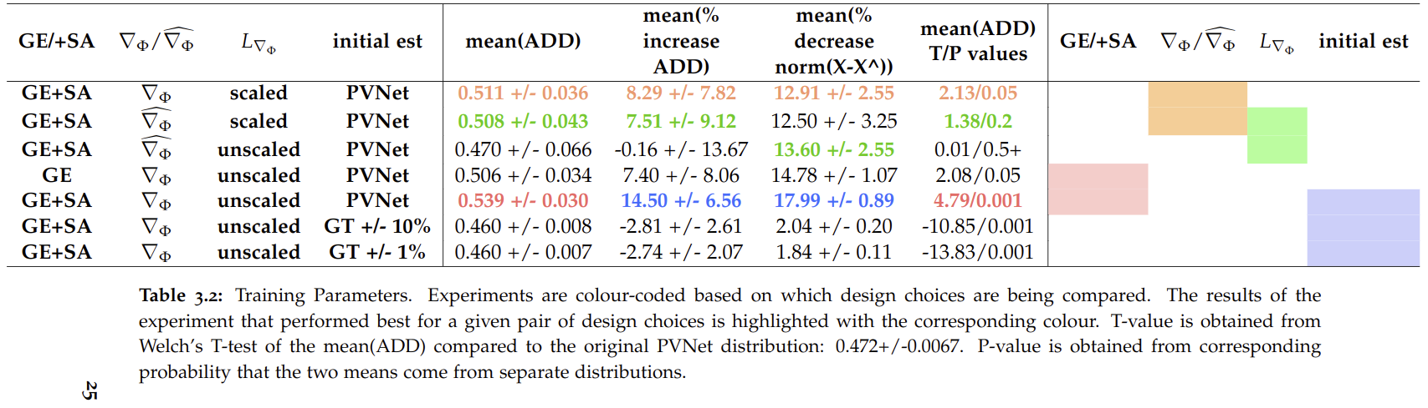
Choosing Parameters
46/57
Notes:
Aside from the iteration parameters, there are a range of training parameters that we have been testing recently.
Some examples are shown in these tables.
[explain tables]
Scaled loss: 1/(X-X^) scaling would add relative emphasis to examples close to the ground truth vector field
Better to: use the State Autoencoder, use the GT gradient vector field, not scale the loss, use PVNet (or a smarter perturbation)

Slide 47
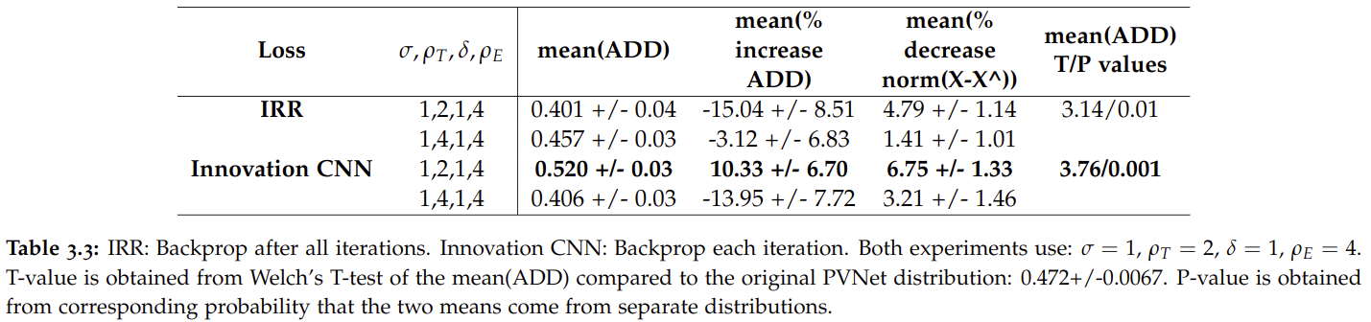
Choosing Parameters
47/57
Notes:
IRR differences: No SA, step size = 1, backprop after all iterations

Slide 48
Initial Results
48/57

Slide 49
Experiments
All experiments were undertaken on the Linemod dataset [1]
Qualitative results are shown for Linemod’s `Ape’ object
[1]
[1] S. Hinterstoisser, K. Konolige, and N. Navab, “Model based training, detection and pose estimation of texture-less 3d objects in heavily cluttered scenes.”
49/57
Notes:
As I mentioned earlier, we’re at the stage at the moment where we’re testing how various design choices effect network performance. We’ve been experimenting with a network trained for 50 epochs on images at one quarter resolution, always on the Ape dataset.
Therefore the results in this section are based on this configuration.

Slide 50
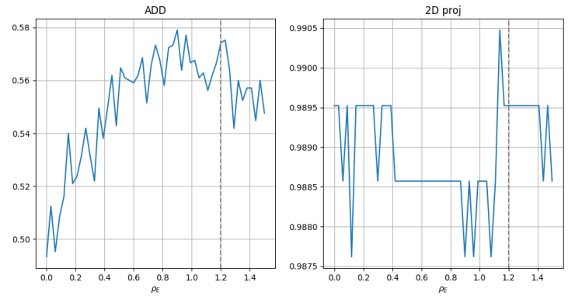
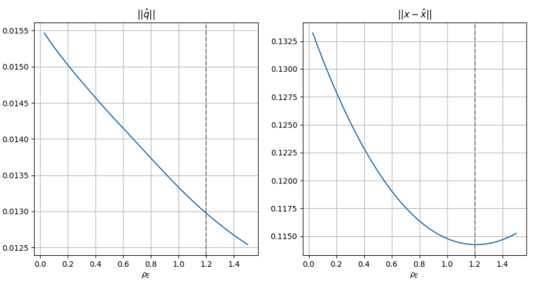
Qualitative Results
Network trained with:
Network evaluated with:
50/57

Slide 51
Quantitative Results
Initial PVNet estimate: 47.2% (ADD metric)
After iterative refinement: 59.8%
Performance increase: ~27% (ADD)
Decrease of ~18% ( )
51/57
Notes:
This is promising, as during the experiments I’ve discussed previously, we have always used 4x downsampling of the input images to increase training speed so we could perform experiments faster. We’re therefore hoping that we’ll be able to get further improvement by increasing the resolution back to full size, now that we have a good handle on how different design choices effect the performance of the network.

Slide 52
Conclusions
We reformulated PVNet to an Innovation CNN for object pose estimation
Obtained an increase in performance of ~27% on the Ape dataset, using the ADD metric
52/57

Slide 53
Next Steps
Train and evaluate on remaining object categories of Linemod dataset
Hope we get a similar performance increase
53/57

Slide 54
TPR: Future Work Proposal
54/57

Slide 55
Pose Estimation
Test on remaining Linemod objects ASAP
Also test on other standard datasets for object pose estimation (Linemod Occlusion and YCP)
Incorporate into a more sophisticated pose estimation pipeline
55/57

Slide 56
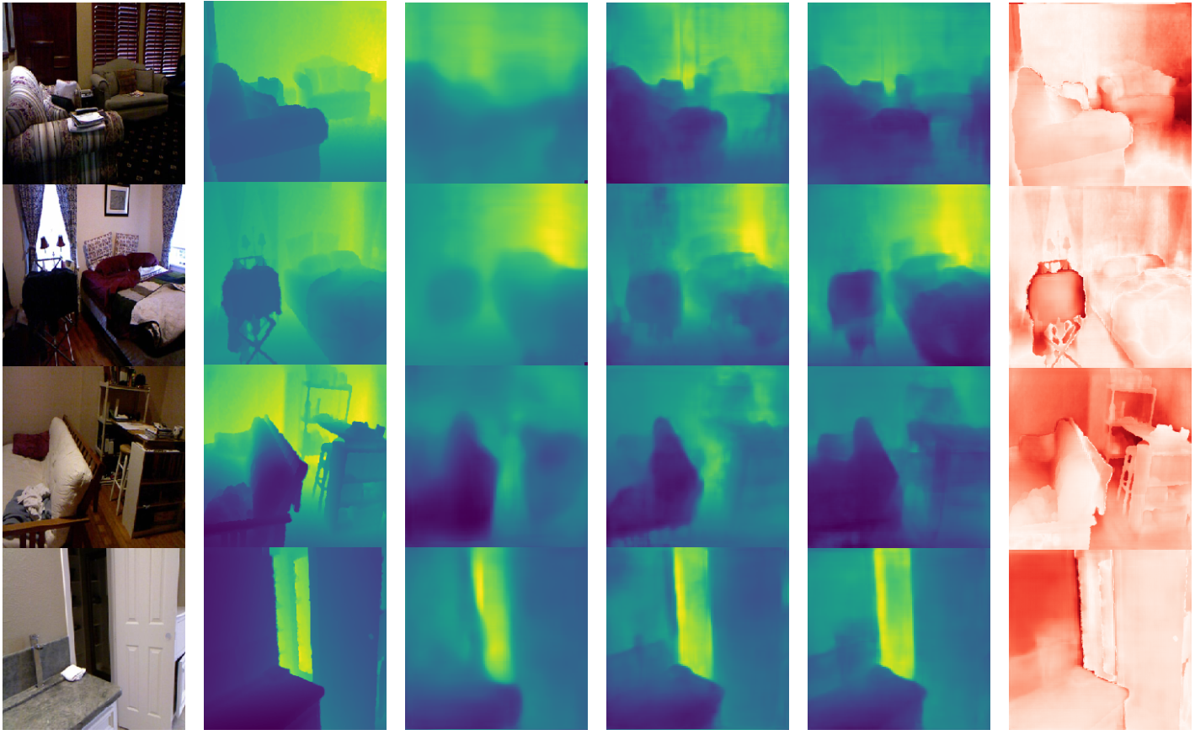
Depth Estimation
Try the same idea on depth estimation from an RGB image
Image from: D. Wofk, F. Ma, T.-J. Yang, S. Karaman, and V. Sze, “Fastdepth: Fast monocular depth estimation on embedded systems,” 2019.
56/57
Notes:
We hope that depth estimation will be a relatively simple problem, as it does not include the additional post processing step involving RANSAC. Therefore, the function that maps state (the network output) to desired output is much simpler.
In hindsight this might have been a better initial application.
Doing this will show the general applicability of our idea to offline estimation problems.

Slide 57
Online Estimation
In our example offline problem the system state is modeled as being stationary. But we could have any system.
Eg. visual odometry observer
57/57
Notes:
As mentioned above, we are hoping that it will prove possible to also incorporate the Innovation CNN into online estimation problems. We think that visual odometry might make sense as the target problem. In this case, the Innovation CNN would be aiming to learn the Innovation update in the VO filtering or observing algorithm.
If we manage all this, it will show that the Innovation CNN can be applied to wide range of online and offline estimation problems.

Slide 58



